Slide 1
Digital Technology
Carlo Mobarak

Slide 2
Storing data in a digital computer
All computers are based on the concept of “digital”.
What does digital mean?

Slide 3
Bits and Bytes
A single 0 or 1 is called a bit.
With one bit, you can’t do a whole lot
The power of computers comes from working with millions, billions, or even trillions of bits per second!
The word byte implies a sequence of 8 bits (a block of 4 bits is called a nibble)
Standard abbreviations for bits and bytes
Lowercase “b” means bits
Uppercase “B” means bytes

Slide 4
Bits/Bytes prefixes
Prefix Abbr. Size
Kilo K 2^10 = 1,024
Mega M 2^20 = 1,048,576
Giga G 2^30 = 1,073,741,824
Tera T 2^40 = 1,099,511,627,776
Peta P 2^50 = 1,125,899,906,842,624
Exa E 2^60 = 1,152,921,504,606,846,976
Zetta Z 2^70 =1,180,591,620,717,411,303,424
Yotta Y 2^80 = 1,208,925,819,614,629,174,706,176

Slide 5
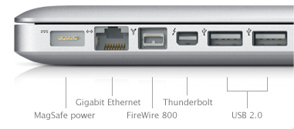
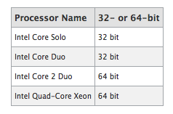
Where are these bits/bytes used?
Here are some examples
Ports:
Processor 64 bit CPU versus 32 bit CPU
Process 8 bytes at a time vs. 4 bytes

Slide 6

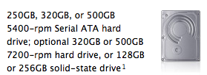
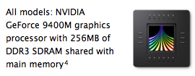
Where are these bits/bytes used?
Primary Memory (RAM)
Secondary Hard disks
Other places as well…

Slide 7
Moving bits in time (“bandwidth”)
Two standard ways to introduce time into the discussion
State Hz (i.e., cycles per sec) rate, with each cycle moving some # of bits) e.g., “DDR-400” memory cards have the following specs: Data Transfer Rate: 400 MHz # of bits moved at a time: 64 bits What data bandwidth does that imply? 64 bits * 400 M cycles/sec = 25,600 M bits /sec = 3,200 MB/sec 3,200 MB/sec is in fact the “Peak Transfer Rate” of DDR-400 memory
We sometimes see the more directly stated Bits/sec (or bytes/sec) values
…see example on next slide

Slide 8
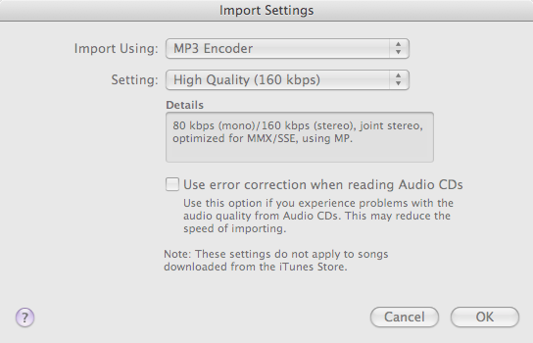
Moving bits in time (“bandwidth”)
From iTunes
80 kbps (mono) … 160 kbps (stereo)

Slide 9
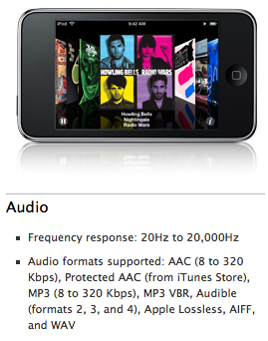
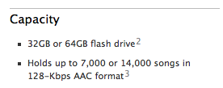
How many mp3 songs?
Does 7,000 songs make sense? (Apple assume 4 min/song)
Each song takes ? MB
Apple-assumed 128 Kbps MP3 = 16 KB / sec * 4 min = 16 KB/sec * 240 sec = 3840 KB = 3.84 MB
32,000 MB / 3.84 MB/song = approx. 8,000 songs

Slide 10
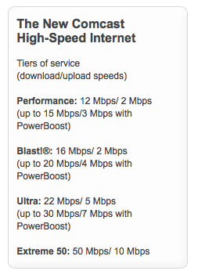
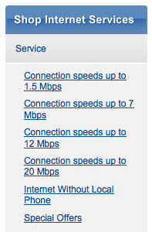
Moving bits in time (“bandwidth”)
From Comcast From QWest
Remember: Mbps (lowercase “b”) means mega bits per second

Slide 11
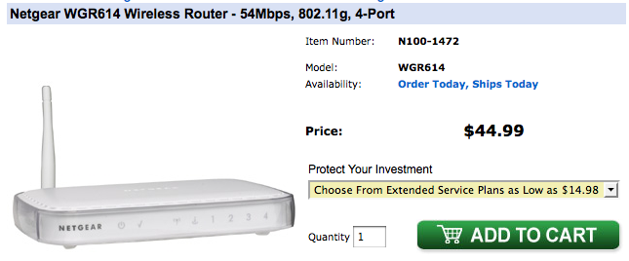
Moving bits in time (“bandwidth”)
Wireless networking
Approx. how many megabytes should you theoretically (i.e., perfect connection, no other users, etc.) be able to transfer wireless per second, using this router?

Slide 12
Be an informed consumer of IT
For example, consider interface bandwidths
USB2 : 480 Mbps
Firewire-400 : 400 Mbps
The latest
USB3 : 5,000 Mbps
Thunderbolt (Apple/Intel collaboration) : 10,000 Mbps
Important concept: these speeds are virtually never realized due to congestion

Slide 13
Using 0’s and 1’s to represent other #’s
Using 0’s and 1’s and a scheme that we devise, we can create correspondences between these bits and our real-world stuff (our “normal” numbers, text, and pictures)
For example, consider the binary counting scheme in contrast with our more familiar decimal counting scheme.
Consider the bits: 1 1 0 0 1
 | 1 | 1 | 0 | 0 | 1
Binary counting scheme | A 16 (2^4) | An 8 (2^3) |  |  | A one
Decimal counting scheme | A 10000 (10^4) | A1000 (10^3) |  |  | A one

Slide 14
Using 0’s and 1’s to represent other #’s
Therefore, looking at the string of values 1 1 0 0 1, using…
Decimal counting, we interpret that string as meaning the quantity eleven thousand and one
Binary counting, we interpret that string as meaning twenty five
Sum = twenty five
 | 1 | 1 | 0 | 0 | 1
Binary scheme | A 16 (2^4) | An 8 (2^3) |  |  | A one
Decimal scheme | A 10000 (10^4) | A1000 (10^3) |  |  | A one
Sum = eleven thousand & one

Slide 15
Using 0’s and 1’s to represent other #’s
Let’s consider a byte’s worth of bits
Minimum possible value: 0 0 0 0 0 0 0 0.
This byte represents the value _______?
Maximum possible value: 1 1 1 1 1 1 1 1.
This byte represents the value _______?
Mathematically, this is 2^8 – 1.
Let’s consider two bytes worth of bits
Consider the string
What number does this represent?
2^16 – 1 is ?
1 1 1 1 1 1 1 1 | 1 1 1 1 1 1 1 1

Slide 16
Using 0’s and 1’s to represent other #’s
Let’s consider another byte
Consider: 0 1 0 0 1 1 0 0.
This byte represents what value?
0 1 0 0 1 1 0 0
2^6, or sixty four
2^3, or eight
2^2, or four

Slide 17
Assigning #’s to keyboard characters
Storing text in a computer (in a “text file”) requires storing all keyboard characters… a-z, A-Z, 0-9, etc. in a file, using bits/bytes
Industry has defined tables (the most popular two being the so-called ASCII table and the UNICODE table) that show an agreed-upon # for every keyboard character
For example, the ASCII table says…
the “G” key has been assigned the # 71
the “4” key has been assigned the # 52
the space key has been assigned the # 32
ASCII table assigns #’s to fewer than 256 characters, and therefore 1 byte is sufficient per character. The UNICODE table assigns #’s to thousands of different keyboard characters (including many languages), and therefore uses two bytes per character

Slide 18
Assigning #’s to keyboard characters
Here is a portion of the ASCII table
Binary | Dec | Keyboard “letter”
0100 0001 | 65 | A
0100 0010 | 66 | B
0100 0011 | 67 | C
0100 0100 | 68 | D
0100 0101 | 69 | E
0100 0110 | 70 | F
0100 0111 | 71 | G
Binary | Dec | Keyboard “letter”
0011 0000 | 48 | 0
0011 0001 | 49 | 1
0011 0010 | 50 | 2
0011 0011 | 51 | 3
0011 0100 | 52 | 4
0011 0101 | 53 | 5
0011 0110 | 54 | 6

Slide 19
Assigning #’s to keyboard characters
Example: Stored as an ASCII text file (e.g., a standard .txt file), the word “Hello” is stored on your computer’s disk as:
01001000 01100101 01101100 01101100 01101111
H e l l o
Example: Stored as an ASCII text file (e.g., a standard .txt file), the word “240” is stored on your computer’s disk as: 00110010 00110100 00110000
This shows that storing numbers as text is not very efficient. “240” in a .txt (ASCII) text file requires 3 bytes, but a computer could store the same # using the binary counting scheme as simply: 11110000.

Slide 20
Assigning #’s to keyboard characters
An implication of storing info. as an ASCII table file (e.g., .standard .txt):
Text stored as ASCII can be opened with any text editor (e.g., MS-Notepad) that uses the industry-standard ASCII table to interpret the data in your file.
This is key if long-term accessibility of data is important to you.

Slide 21

Assigning #’s to keyboard characters
Another implication: A file may look as if it’s corrupted simply because the computer, perhaps due to a file-extension issue, is interpreting the 0’s and 1’s using the wrong scheme.
For example, consider some normal text such as my initials MP. Stored as a standard ASCII file, M = 77 and P = 80, so this would be stored in a standard (ASCII) text file as: “01001101 01010000”
If I loaded this data file into a program that use a UNICODE table to interpret the data, the program will show because that is the Chinese character the UNICODE table assigns to 0100110101010000.
If I loaded the same file into a program that applies the binary counting scheme to the 16 bits, it will show that data as 19792, because that is the decimal equivalent of that 16-bit value..

Slide 22
Aside: how I determined the character is:
To see how I determined the Unicode character, we will learn later in these slides that 0100 1101 0101 0000 can be written as: 4 D 5 0 (in “Hex”).
Nearly all web lookups for Unicode characters are based on Hex representations, and the syntax for signaling you are looking up a Unicode character is to put a “U+” in front of the Hex code. So, in Google, try the query
You will see by running this Google query that you can find out the UNICODE character for 4D50 (=01001101 01010000) is indeed the Chinese character shown.

Slide 23
Assigning #’s to keyboard characters
Summing up the prior slide, the disk data: 0100110101010000
…interpreted as two 8-bit #’s: 77 80
…interpreted as one 16-bit #: 19792
…interpreted as two ASCII letters: M P
…interpreted as one 16-bit UNICODE letter:
As we will see, the value could even represent a color or even sound.
Remember that a data file may appear corrupted when in fact the issue is that your app is interpreting the bits/bytes using the wrong scheme.
Changing the file extension or an import setting may be all that is required to “recover”/view your data correctly

Slide 24
ASCII / UNICODE text is “dense”
As we will see, a nice thing about ASCII (or UNICODE) text storage, compared to storing pages as pictures, is that relatively little data is required when each character requires only 1 (or 2) byte(s).
Example: assume 20,000 pages of text will be scanned per month with OCR (optical character recognition) software, and archived as simple ASCII text. Assume 2500 characters per page.
Estimated requirement over next year:
20,000pages/month * 2500 characters per page * 12 months = 600,000,000 characters
Stored using an ASCII table, each character requires 1 byte.
Therefore, 600 million characters * (1 byte / character) = 600 million bytes = 600 MB.
Note: the annual archive will fit on 1 CD-ROM with space to spare!

Slide 25
Digital storage of images
A bitmap image is a grid of dots called pixels.
Below is a representation of a 10 x 10 image, consisting of 100 pixels
If each pixel is restricted to be of only 1 of 2 possible colors, for example black or white, then only 1 bit would be needed to store the information about each pixel.

Slide 26
Digital storage of images
If each pixel can be one of 256 colors, then 8 bits are needed for each pixel.
More possible colors requires more bits per pixel.
The # of bits per pixel is referred to as “color depth.”
8 bit → 2^8, or 256 different colors
24 bit → 2^24 (or 16,777,216 to be exact!)
32 bit → 2^32 (or 4,294,967,296 to be exact!)
24 bit color depth is called “True Color”
This is a standard for magazine layouts / publishing

Slide 27
Picture storage requirements
How many bytes are required to define all the pixels in a standard bitmap picture (.bmp)?
Formula
(# pixels) * (color depth)
= (# rows) * (# columns) * (bits or bytes per pixel)

Slide 28
Estimating picture storage requirements
Example: a high resolution 2000 x 1500 “wall-paper” image with 24-bit color depth
How many pixels are in the image?
2000 * 1500 = 3,000,000 pixels
How many bits are implied?
(3,000,000pixels) * 24 bits/pixel = 72,000,000 bits
How many megabytes?
72,000,000 bits * (1 byte / 8 bits) = 9,000,000 bytes = 9MB

Slide 29
Understanding audio storage requirements
How many bytes are required to record sound?
Intuitive Per-channel formula: (# of seconds of audio) * (sample rate per second) * (sample depth)

Slide 30
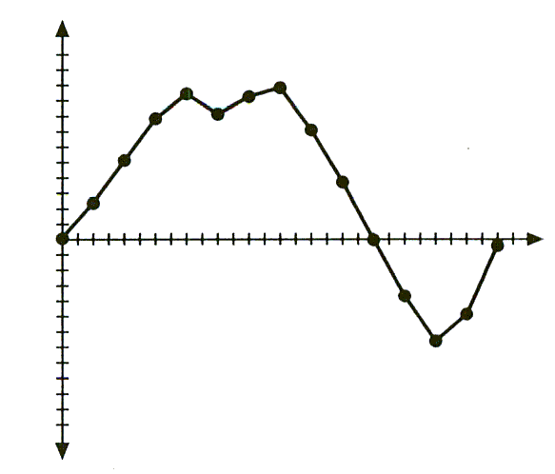
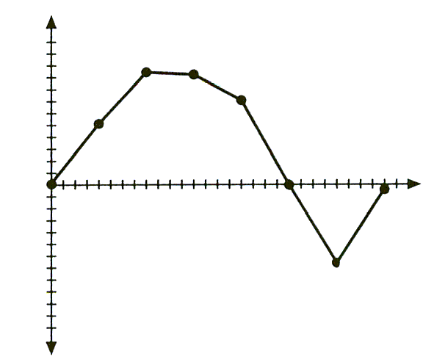
Sample Rate
Sampling is the process of representing the original analog wave using digitized points.
Each dot below is a sample.
Typical sampling rates vary from 10kHz to 100kHz. 44,1000Hz, or 44.1kHz, is the CD-audio standard.

Slide 31
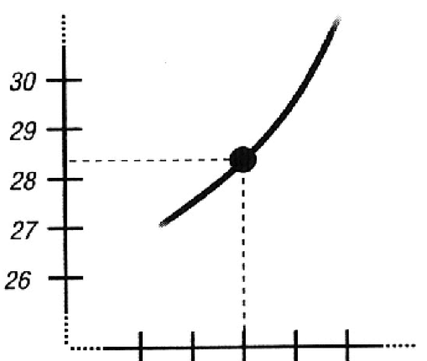
Sample Depth
The sampled audio wave position must be assigned a value.
How many possible values can we assign to that wave position?
Depends on the sampling depth
Analogous concept to color depth
E.g., rather than record the sound level 28.3 as 28 (or 29), we would prefer to have, say, 2 more bits of sample depth, which would give us 4X more values (for example: 28, 28.25, 28.5, and 28.75 rather than just 28). In that case, the round-off error from storing 28.3 as 28.25 would be very small

Slide 32
Sample Depth
Greater sampling depth provides more possible values
Common sampling depth is 16 bits
How many possible values?
As with color depth limitations due to people’s eyes, people’s ears have trouble discerning benefits from going above 16 bits
Standard CD audio uses 16-bit sampling depth
High-definition DVD-Audio standard employs 24-bit sampling depth (and 96,000 Hz sampling rate)

Slide 33
Estimating audio storage requirements
Example: estimate bytes needed for 5 channels of CD-quality sound (i.e., 44,100 sampling rate, with 16 bit sampling depth), assuming a 50 minute performance.
For each of the 5 channels, we have: (sec.) * (sample rate) * (sample depth)
= (50min * 60sec/min) * 44.1kHz * 2 bytes
=264,600k bytes = 264 MB
So, for all 5 channels, we have 5 * 264MB = 1.3 GB
Related question: why did SONY/Philips decide to make CD-audio a 2-channel standard, rather than a surround sound (e.g., 5 channel) standard?

Slide 34
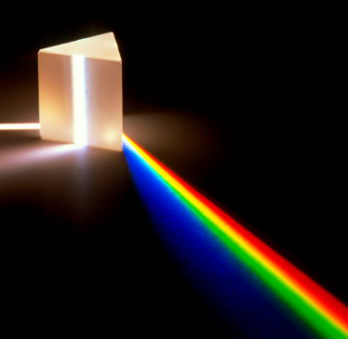
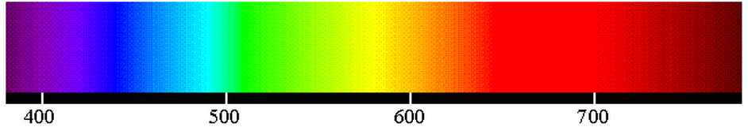
Addendum: the RGB color scheme
In web pages (and other contexts), each color is represented as some combination of red, green, and blue. The scheme is called RGB.

Slide 35
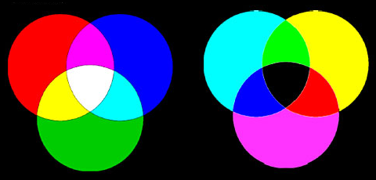
Mix light
Mix pigment
Notes:
When mixing finger paint, you were mixing different color paint (pigments). When light hits a surface that is painted a certain color, all the other wavelengths are absorbed and that color is reflected.The more colors you add to the mix, the more light is absorbed – the color gets darker and darker.
This is in contrast to the computer display, which adds different colors of light. Additive color systems start without light (black). Light sources combine to make a color. As colors are added, the resulting color is brighter.

Slide 36

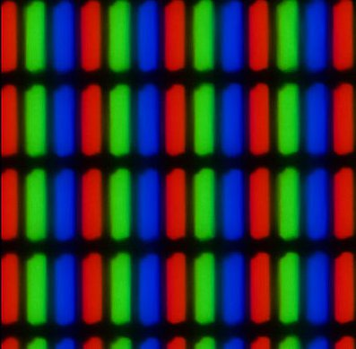
Display sub-pixels show red, green, and blue
Notes:
Magnifying a screen about twenty times makes the sub-pixels visible.

Slide 37
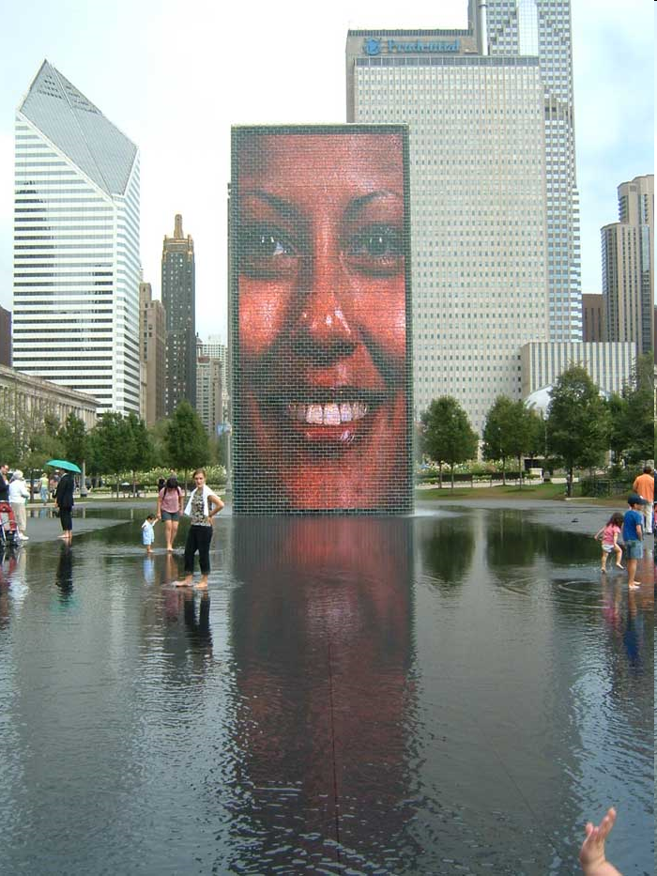
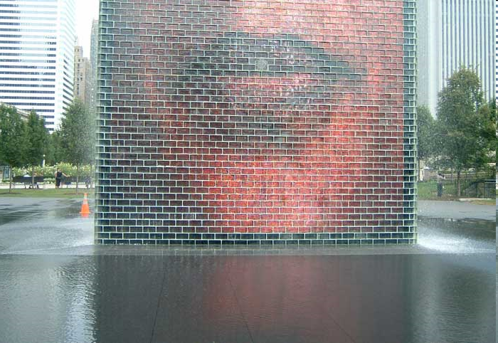
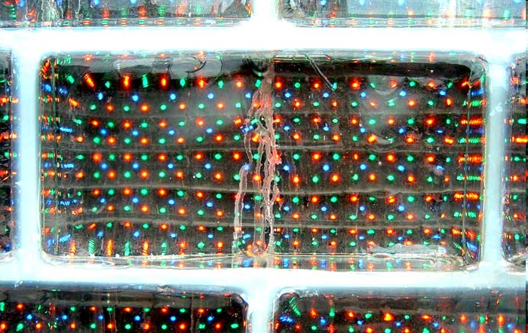
RGB displays at Millennium Park, Chicago
Notes:
Two of these displays face each other in a shallow pond in Millennium Park.
Tbe display is comprised of many separate “bricks” in clear plastic.
And each brick contains red, green and blue lights.

Slide 38
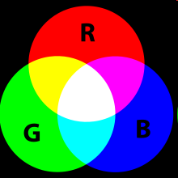
For each pixel, combine three primary colors
Intensities of each color can range from 0 - 255
Notes:
A computer display combines red, green and blue light at varying levels of intensity to determine the color of each pixel.
Red, green and blue are “primary” colors, because you cannot make them by mixing other colors, but you can create other colors by mixing them.

Slide 39
A few examples
Color | Red | Green | Blue
Red | 255 | 0 | 0
Green | 0 | 255 | 0
Blue | 0 | 0 | 255
Yellow | 255 | 255 | 0
Cyan | 0 | 255 | 255
Magenta | 255 | 0 | 255
White | 255 | 255 | 255
Black | 0 | 0 | 0
Notes:
Here we see examples of the color resulting from varying light intensities.
Setting red to 255 and the others results in a red pixel.
Mixing all three results in white.
No light results in black.
Other mixes result in other colors.

Slide 40
Example: representing Magenta
In decimal (base-10): 255 0 255
In bytes (base-2): 11111111 00000000 11111111
Notice that the binary representation is very long!
IT users want a less cumbersome form, so they use the base-16 (“Hexadecimal”) format: FF 00 FF
Check out a popular website such as Amazon.com
view the HTML; you see many 6-hex-character strings!

Slide 41
0
1
2
3
4
5
6
7
8
9
10
11
12
13
14
15
16
17
18
19
20
21
0
1
2
3
4
5
6
7
8
9
A
B
C
D
E
F
10
11
12
13
24
25
Counting in
hexadecimal
Decimal counting
Hexadecimal counting
…
…
255
FF
Notes:
What are those “hex” numbers in an earlier slide?
You are used to counting using our familiar decimal number system, which has ten symbols (glyphs): 0, 1, 2, … 9.
Programmers and Web developers often count in hexadecimal, which has 16 glyphs: 0, 1, 2, … 9, A, B, C, D, E, F.
What happens in decimal when we move from nine to ten?
Since there is no symbol for the quantity 10 in the decimal number system, we write zero and carry one to the next position to the left.
The same thing happens with hexadecimal numbers, but we do not run out of glyphs until we reach F.
The number that comes after F is written a zero carry one.
The bottom line is that hexadecimal is just a different way to write numbers.
Since there are more glyphs, hexadecimal numbers are generally shorter than decimal numbers.

Slide 42
Why the heck do IT folks bother with hex?
One reason: because it’s dense (short)
Another reason: because it’s trivial to convert from binary to hex, by working with four bits (a “nybble”) at a time.
Given any bit string, start from the right and replace each block of four bits with the corresponding hex symbol.
Example: 1101 0011
Converting to decimal is hard work!
= 1*2⁷ + 1*2⁶ + 1*2⁴ + 1*2¹ + 1*2⁰ = 128 + 64 + 16 + 2 + 1 = 211
In contrast, converting to hex is trivial
1101 0011 converts to the hex string D3.
0011 is the value 3 which we (also) write as 3 in hex.
1101 is the value 13 which we write as D in hex.
Notes:
Consider the 9-bit microcontroller by QuickCores.com

Slide 43
The sixteen hex symbols
Binary Hex Decimal
0000 0 0
0001 1 1
0010 2 2
0011 3 3
0100 4 4
0101 5 5
0110 6 6
0111 7 7
Binary Hex Decimal
1000 8 8
1001 9 9
1010 A 10
1011 B 11
1100 C 12
1101 D 13
1110 E 14
1111 F 15

Slide 44

Examples from Amazon.com homepage
a:link { font-family: arial; color: #004B91; }
a:active { font-family: arial; color: #FF9933; }
a:visited { font-family: arial; color: #996633; }
These three lines set colors for hyperlinks before visited, the moment the link is clicked, and after the link has been click. What are these colors?
Using the first example:
004B91 → 0000 0000 0100 1011 1001 0001
Decimal… 0 75 145
So, no red, some green, more blue… colorpicker.com shows:

Slide 45
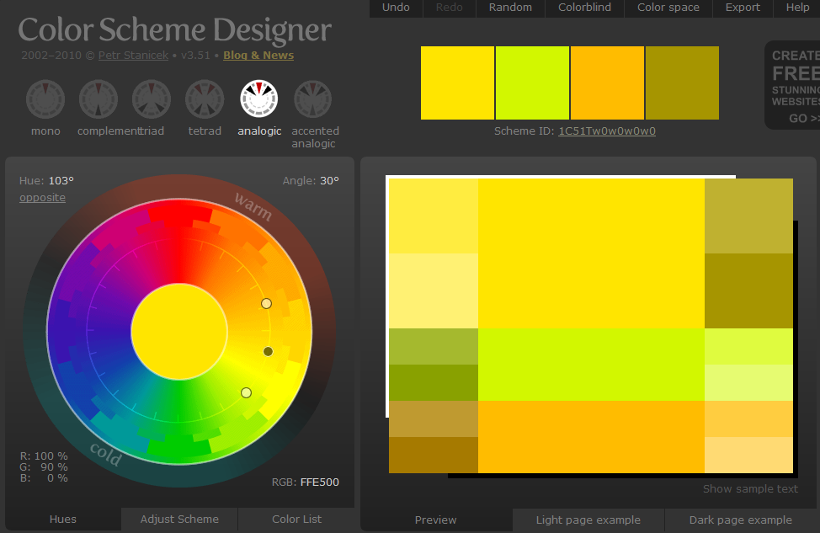
Notes:
This program lets you set and see RGB colors and also helps you pick colors that go well together.

Slide 46

Podcast on color philosophy and physiology
To what extent is color a physical thing in the physical world, and to what extent is it created in our minds?

